Slide 1
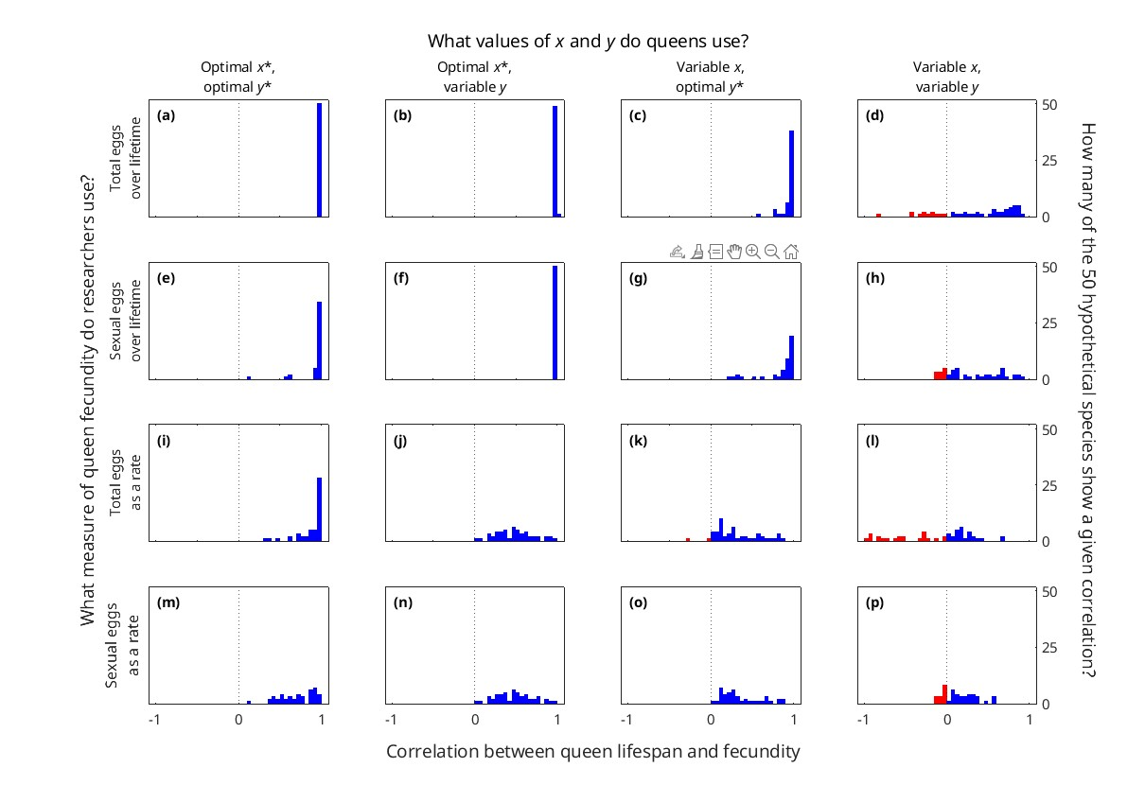
Figure_4_spline_old_01.jpg.
Produced with Figure_4_Correlations.m, which loads categories_2025-01-25_spline.mat

Slide 2
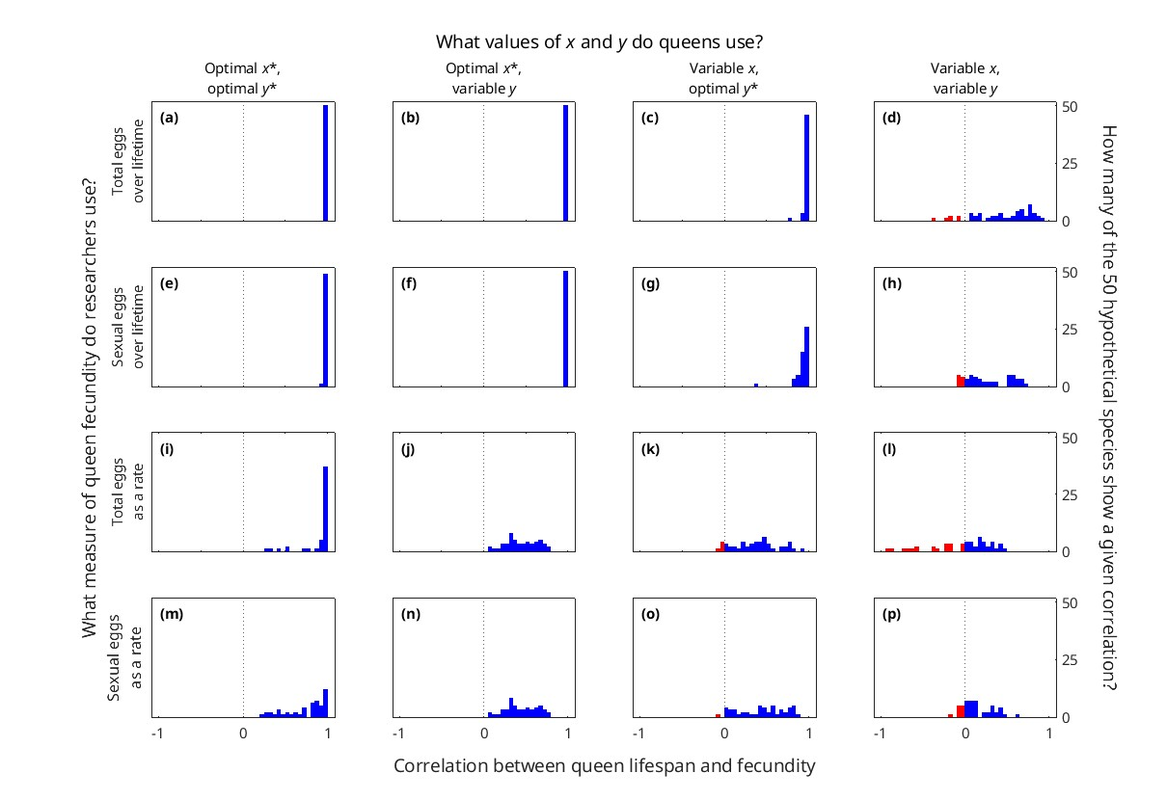
Figure_4_csaps_new_01.jpg.
Produced with Figure_4_Correlations.m, which loads categories_2025-03-18_01.mat

Slide 3
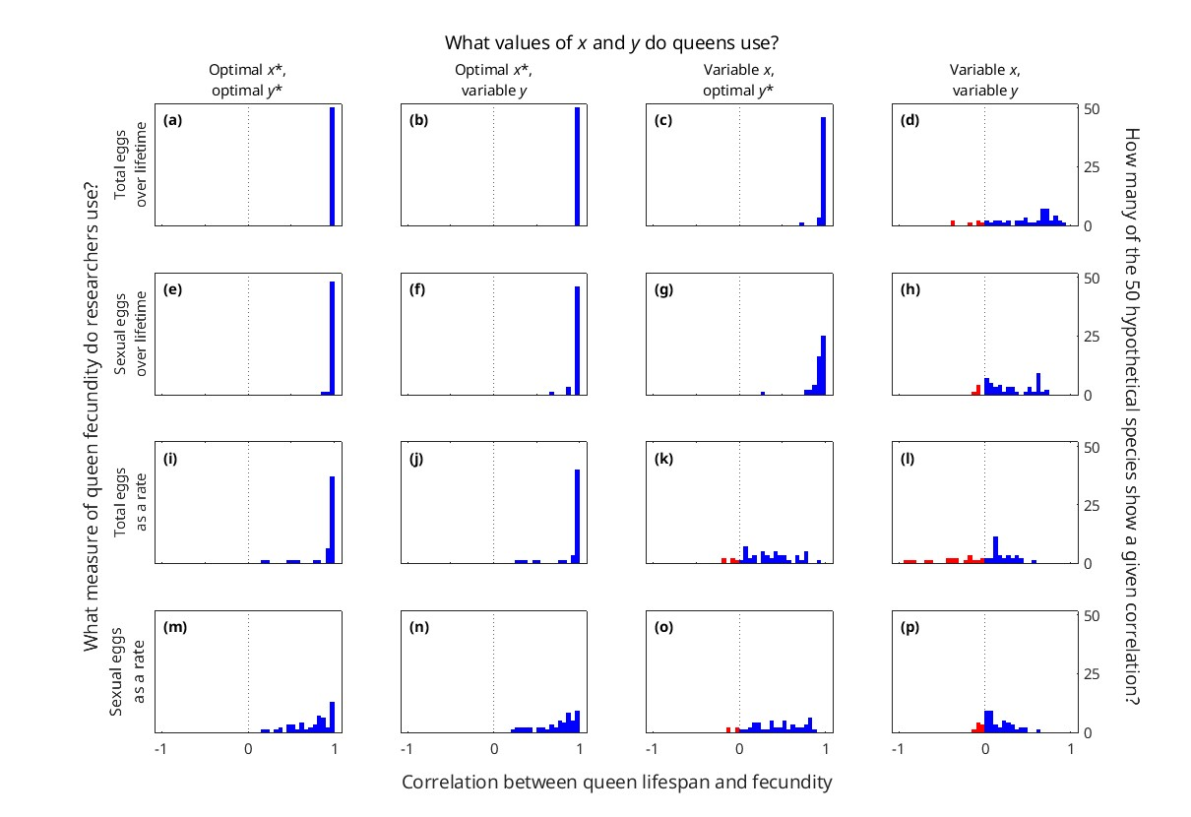
Figure_4_csaps_new_02.jpg.
Produced with Figure_4_Correlations.m, which loads categories_2025-03-18_02.mat

